Slide 1
PROJECT NAME - BOOKSWAGON RLL Group- 5
GROUP MEMBERS: EMPID:
Balaji S (Team Lead) 2587274
Ayush Malik 2587218
Renitha Shri Mohan 2587267
Sagar Konkati 2586696
Mangu Dileep Krishna 2587338
Kavya Ravichandran 2586734
Gorla Mounika 2587264
Munagala Himabindhu 2587205

Slide 2
URL FOR AUT:
https://www.bookswagon.com
Functionalities:
Register &Login Page(Munagala Himabindu)
Personal Settings(Renitha Shri Mohan)
Shopping Cart(Mangu Dileep Krishna)
Search/Refine your Search(Kavya Ravichandran)
Award Winners/Sort By(Gorla Mounika)
Request A Book(Sagar Konkati)
My Wishlist(Ayush Malik)
Add Address(Balaji S)

Slide 3
AGENDA
I
INTRODUCTION
II
SELENIUM
III
CUCUMBER
IV
V
VI
VII
VIII
TESTNG
POM FRAME WORK
LISTNERS & RETRY ANALYSER
EXTENT REPORTS & LOGS
DATA –DRIVEN
IX
X
JIRA
OUTPUTS

Slide 4

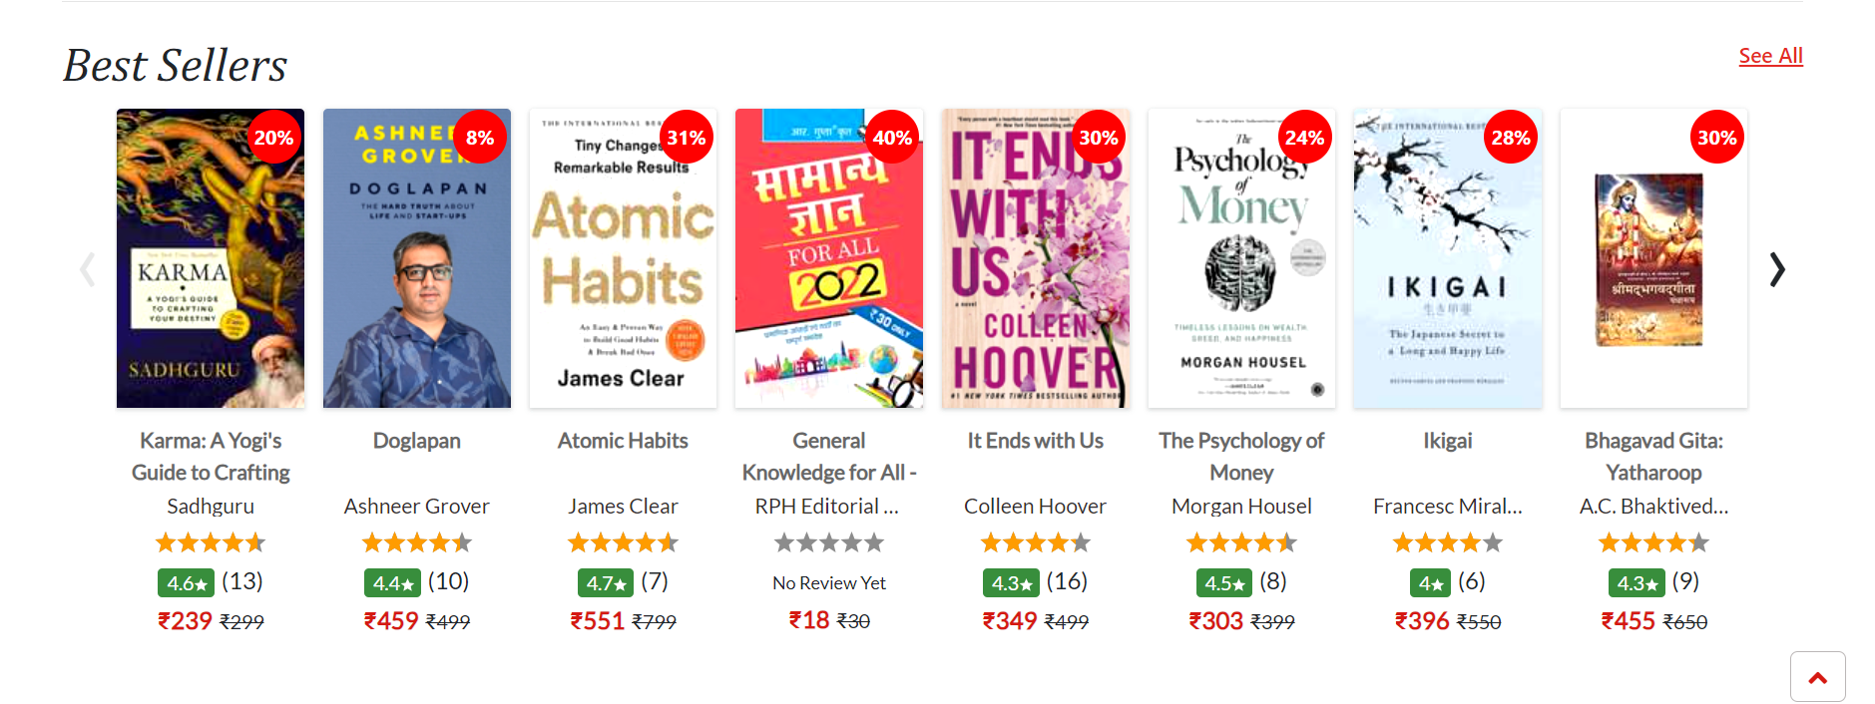
BOOKSWAGON.COM
BooksWagon.com is a leading online platform for purchasing a wide range of books. The platform offers an extensive collection of books across various genres, ensuring customers have access to an array of reading materials catering to their diverse interests and preferences.

Slide 5
INTRODUCTION
In this project we are testing the functionalities of the website: Bookswagon.com
First we have started testing with writing the manual test cases.
The tools and Frameworks that we have worked with are Selenium, TestNG, and Cucumber.
We have created the extent reports and generated logs.
For the failed test cases we have used IRetryAnalyser and screenshots for capturing the failed test cases.
We have Excel to read data.
In this project, we have used Jira for the test management lifecycle.

Slide 6


SELENIUM
1
Open Source Tool
Selenium is an open-source tool that enables testers to automate web applications across different browser
2
Multi - Browser Support
It supports multiple browsers like Chrome, Firefox, Safari and Internet Explorer, making it a versatile choice of testing.
3
Automated Testing
With Selenium, testers can perform automated testing of web applications, reducing manual effort and ensuring consistent test results.

Slide 7
ADVANTAGES OF SELENIUM
Automation Efficiency
Cross Browser Testing
Parallel Execution
Selenium enables efficient automation of repetitive testing tasks, saving time and effort.
It allows testing across different browsers to ensure the web application's compatibility and consistency.
Selenium supports parallel test execution, allowing for faster test suites and reduced testing time.

Slide 8
SELENIUM WEBDRIVER
Efficient Web Element
Interaction
Browser Compatibility
Dynamic Test Configuration
Selenium WebDriver provides a user-friendly API for interacting with web elements, ensuring seamless execution of test scripts.
It offers extensive support for different browsers, allowing testers to execute the same test scripts across various environments.
With Selenium WebDriver, dynamic test configurations are easily achievable, enhancing test coverage and accuracy.

Slide 9
SELENIUM IDE
Record and Play Back
Intitutive Test Creation
Debugging Capabilities
Selenium IDE allows testers to record and save interaction with the Web application, enabling easy playback for testing scenarios.
It offers a user–friendly interface for creating test cases with minimal it is suitable for beginners and experienced testers alike..
It provides robust debugging features, facilitating efficient identification and resolution of issues within the test scripts.

Slide 10


CUCUMBER
Cucumber is a powerful open-source testing tool that facilitates Behavior-Driven Development (BDD) by allowing collaboration between developers, testers, and non-technical stakeholders. It is widely used for automating acceptance tests written in a natural language format, known as Gherkin, making it accessible to individuals with varying technical expertise.

Slide 11
KEY FEATURES OF CUCUMBER
Feature Files
Step Definitions
Tags
Rich Reporting
Tests are written in a readable and understandable format, making it easy for non-technical stakeholders to participate.
Each step in the feature file is associated with a piece of code that defines the actions to be taken.
Allows the user to group the scenarios and execute specific sets of scenarios using tags.
Reports include information about the executed scenarios, passed and failed steps, and overall test results.

Slide 12
How to create Cucumber Project
1
Create project:
First, create a maven project, then convert it into cucumber.
2
Create feature file:
Add cucumber dependencies and write down the features and scenario.
3
Step definition:
Each steps of the feature file is mapped to a piece of automation code.
4
Run project:
Then run the code from the Test runner class.

Slide 13
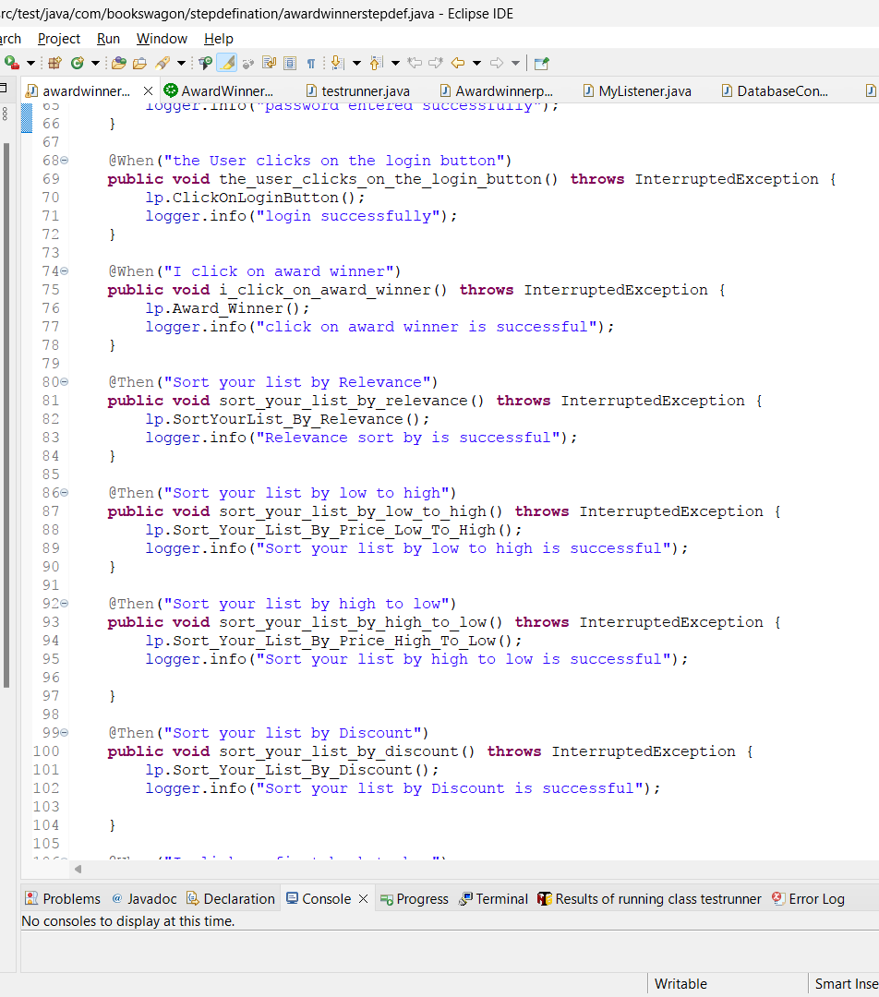
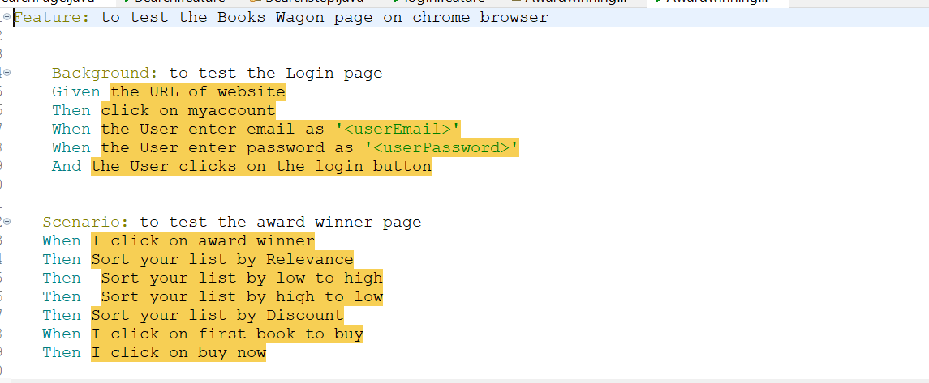

Slide 14
ADVANTAGES OF USING SELENIUM
1
Collaboration 🤝
2
Reusability ♻️
Cucumber promotes collaboration between technical and non-technical stakeholders by writing test cases in plain, understandable language.
Test scripts in Cucumber can be easily reused, saving time and effort in creating new test cases.
3
Documentation📝
4
Early Bug Detection🐞
Cucumber generates living documentation, making it easier to understand test cases and their purpose.
It helps in identifying and fixing bugs at an early stage of the development process.

Slide 15

TESTNG
TestNG is a JUnit-inspired testing framework. It provides several features like data-driven testing, parameterization support, running test cases in parallel, test case grouping, etc. All these features help in creating robust and powerful testing projects.
We can simply convert a method or function to a test by adding an annotation – @Test on top of it. A simple test in Java looks like this-
“@Test
public void sampleTest() {
//Any test logic
System. out.println("Hi! ArtOfTesting here!");
}”
Now, either in case of exception or in case of assertion failure, the test case will be marked as Failed. Else, the test will be marked as Passed.

Slide 16
Features of TestNG:
Annotations
Test Suites
Parameterized Testing
Parallel Execution
Groups
Listeners
Annotation:
TestNG Annotations are used to control the next method to be executed in the test script. TestNG annotations are defined before every method in the test code.
@Test
@BeforeSuite and @AfterSuite
@BeforeTest and @AfterTest
@BeforeClass and @AfterClass
@BeforeMethod and @AfterMethod
@DataProvider
SV

Slide 17
Test Suites:
Test suites are the logical grouping or collection of test cases to run a single job with different test scenarios. It is represented by one XML file, as suite is the feature of execution.
Groups:
TestNG allows you to categorize your test methods into groups using the @Test(groups = "group_name") annotation. This is useful for selectively running tests based on their group assignments.
Parallel Execution:
TestNG supports parallel execution of tests, allowing you to run tests in parallel on multiple threads or even across different machines. This can significantly reduce test execution time.
Assertion:
TestNG includes a variety of assertion methods for validating expected results.
If an assertion fails, TestNG marks the test as failed and continues with the next test.
We have two types of Assertions: Hard Assertion and Soft Assertion.

Slide 18
ADVANTAGES OF TESTNG
The main advantages of TestNG can be listed as follows:
TestNG provides parallel execution of test methods.
It allows to define dependency of one test method over other methods.
It allows to assign priority to test methods.
It allows the grouping of test methods into test groups.
It has support for parameterizing test cases using @Parameters annotation.
It allows data-driven testing using @DataProvider annotation.
It has different assertions that helps in checking the expected and actual results.
Detailed (HTML) reports.
V

Slide 19

Definition:
POM -page object model.​
It is a design pattern commonly used in software test automation To
enhance the maintainability, reusability, and readability of automated
test scripts.​
It provides a structured way to organize and manage interactions with
web pages or user interfaces in an application.​
The page object model is to represent each web page o UI component
As A separate class, known as A “page class”.
POM FRAMEWORK
​

Slide 20

USES OF THE POM
This Design Pattern is used in Selenium where web pages are represented by a corresponding class and web elements are represented by the variables of the class and all interactions are possible through the methods or say functions of the class.
Is a design pattern in Selenium that creates an object repository for storing all web elements.​
It helps reduce code duplication and improves test case maintenance. In Page Object Model, consider each web page of an application as a class file.
SV

Slide 21
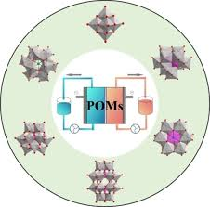
ADVANTAGES OF POM
1
Code Reusability
This reduces duplication and enhances Maintainability.
2
Enhanced Maintainability
The separation of concerns in POM leads to improved
maintainability of test scripts.
3
Improved Readability
It makes scripts more understandable and easier to troubleshoot.

Slide 22
LISTENERS
TestNG listeners are interfaces that can be implemented to extend the behavior of TestNG, such as modifying test results, logging test execution details, or adding custom reports.
Listeners are the piece of code that listens to every event that occurs in different stages of the test execution lifecycle in the TestNG.
It is activated either before the test or after the test case.
Use cases for TestNG listeners:
Test execution monitoring: TestNG listeners can be used to monitor the execution of tests, such as logging the start and end times of tests or tracking test results.
Custom reporting: TestNG listeners can be used to generate custom reports that provide detailed information about test execution, such as the number of passed/failed tests or the duration of each test and taking snapshots.
Test failure analysis: TestNG listeners can be used to analyze test failures and provide detailed information about the cause of the failure, such as stack traces or debug information and can be customized for failed test cases retry.

Slide 23
TYPES OF TESTNG LISTENERS
Listeners can be implemented in two ways in TestNG:
At the class level: Annotating listeners on each class in the test code.
At the suite level: Define the class names to implement listeners in the TestNG XML file.
ITestListener:
ITestListener is the most used listener in TestNG.
ITestListener is an interface implemented in the class, and that class overrides the ITestListener-defined methods.
It is used to listen to the test events like test start, fest success, testfailure, etc.
Methods of ITestListeners:
onTestStart()
onTestSuccess()
onTestFailure()
onTestSkipped()
onTestFailedButWithinSuccessPercentage()
onStart()
onFinish()

Slide 24
BENEFITS OF TESTNG LISTENERS
Test Data Manipulation:
Listeners provide hooks to modify or manipulate test data during runtime. You can use listeners to dynamically update test data, parameters, or configurations before or after each test case execution.
Test Execution Control:
Listeners allow you to define conditions and logic for executing or skipping tests based on specific criteria.
Test Parallelization:
TestNG parallel test execution and listeners play a crucial role in parallel test management.
Enhanced Test Reporting:
By implementing listeners, you can capture and log events occurring during test execution, such as test case start, test case failure, test case success.

Slide 25
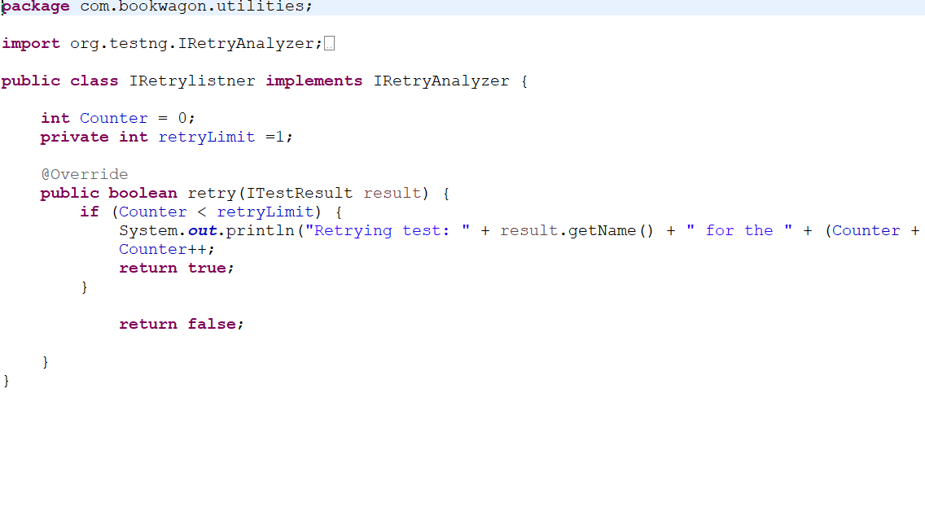
IRetryAnalyzer
IRetryAnalyzer is a TestNG interface, not a listener.
It is used to implement custom retry behavior for failed tests in TestNG with the help of Annotation Transformer listener.
To associate your test cases with IRetryAnalyzer. In order to do this, you need to use the method below.@Test(retryAnalyzer = Retry.class) public void testCase() { }

Slide 26
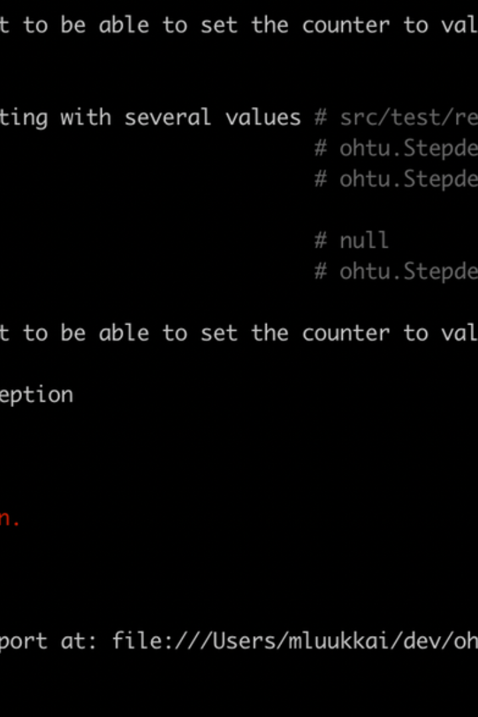

EXTENT REPORTS
Extent Reports is an open source reporting library useful for test automation.
It can be easily integrated with major testing frameworks like Junit , TestNG , cucumber etc.
These reports are mainly HTML documents that depict results as pie charts.
They also allow generation of screenshots , logs and other details.
Once an automated test scripts runs successfully , testers need to generate test execution reports in order to understand clearly about the results.

Slide 27
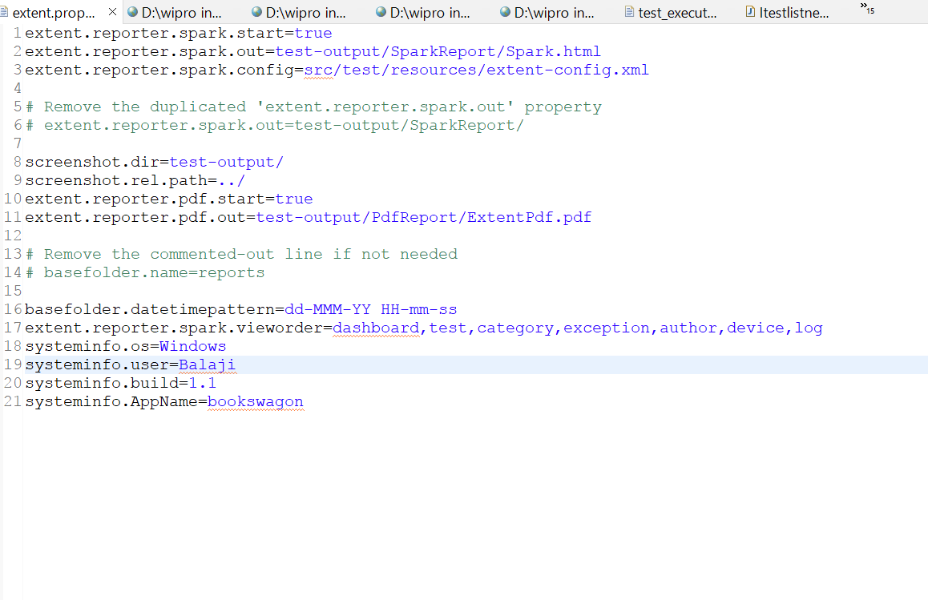
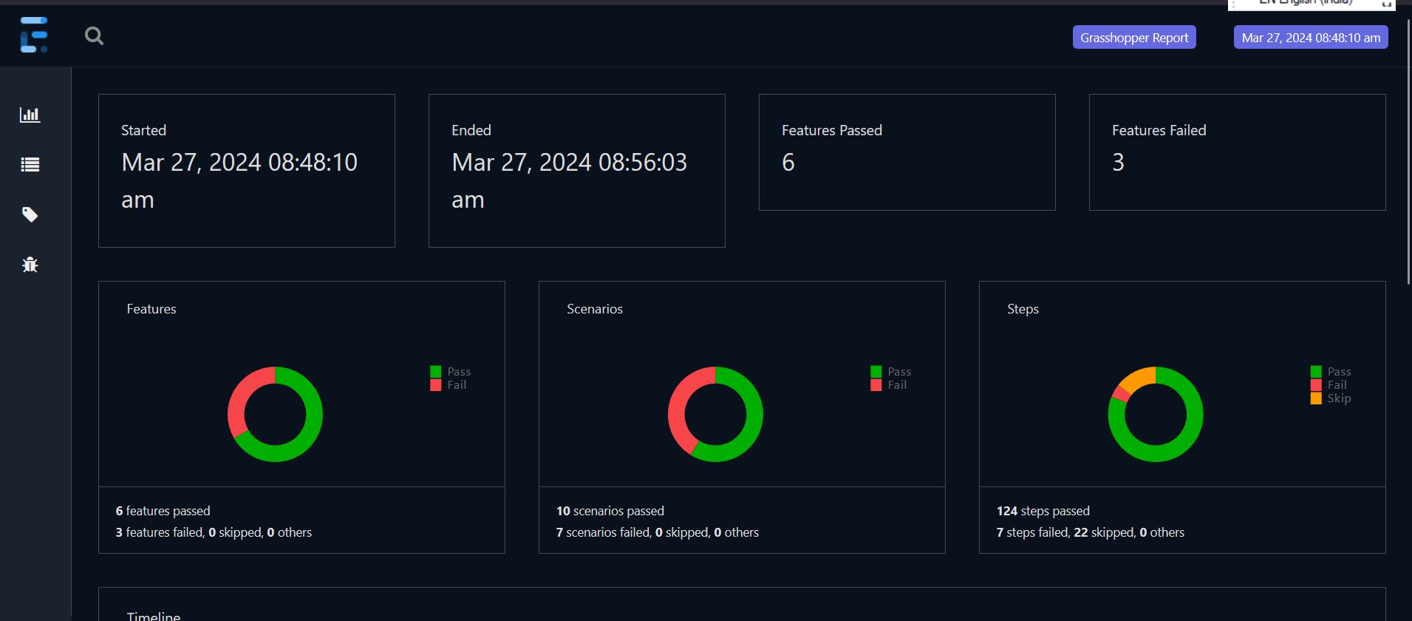
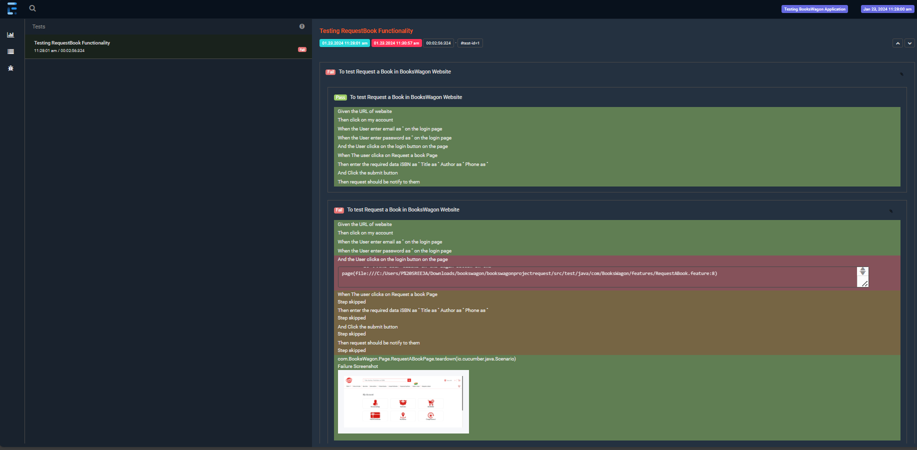
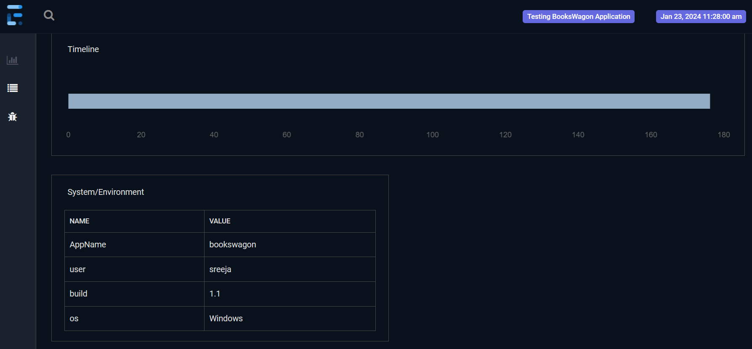
CODE SNIPPET OF EXTENT REPORTS

Slide 28
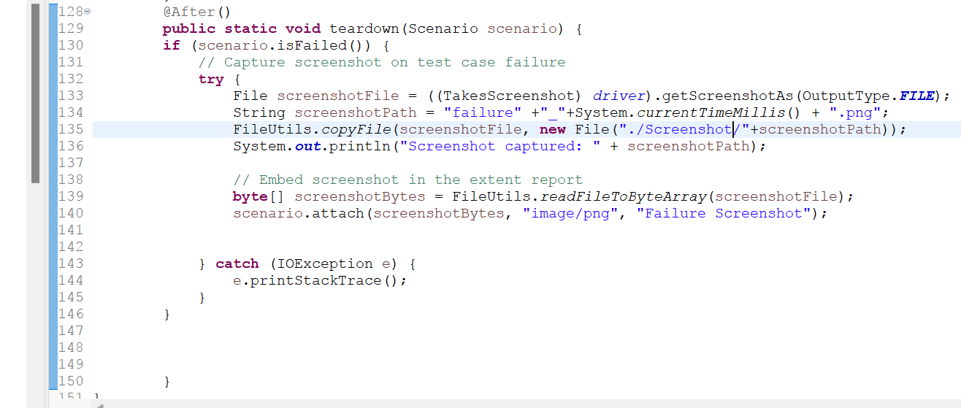
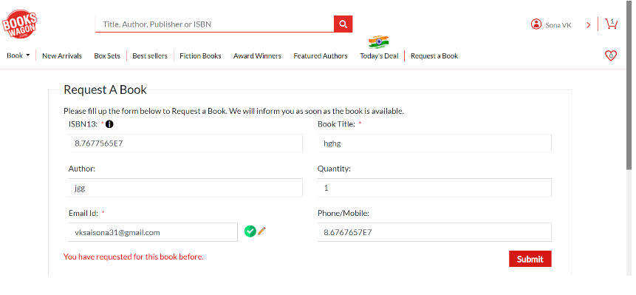
SCREENSHOTS
By capturing screenshots , testers can easily identify what and where the test fails during the testing and captures the screenshot only when a test fails.
Call getScreenshotAs method to create image file.
OutputType defines the output type(Failure Screenshot) for the required screenshot.

Slide 29
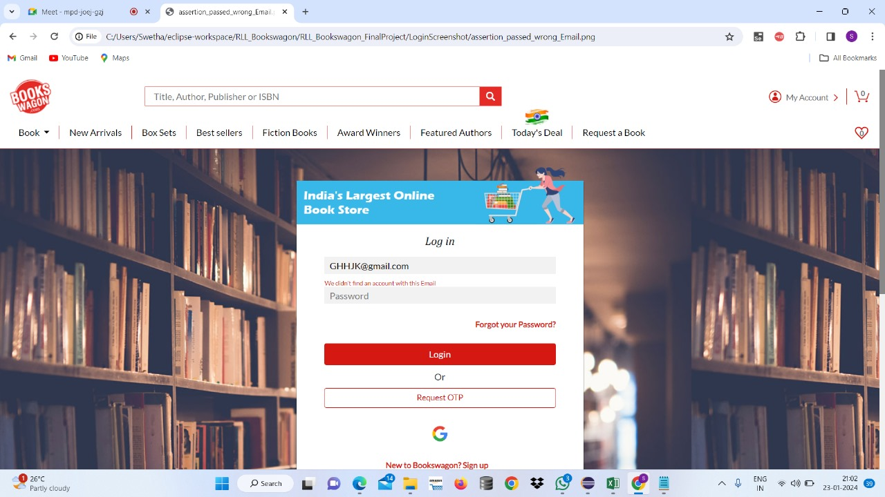
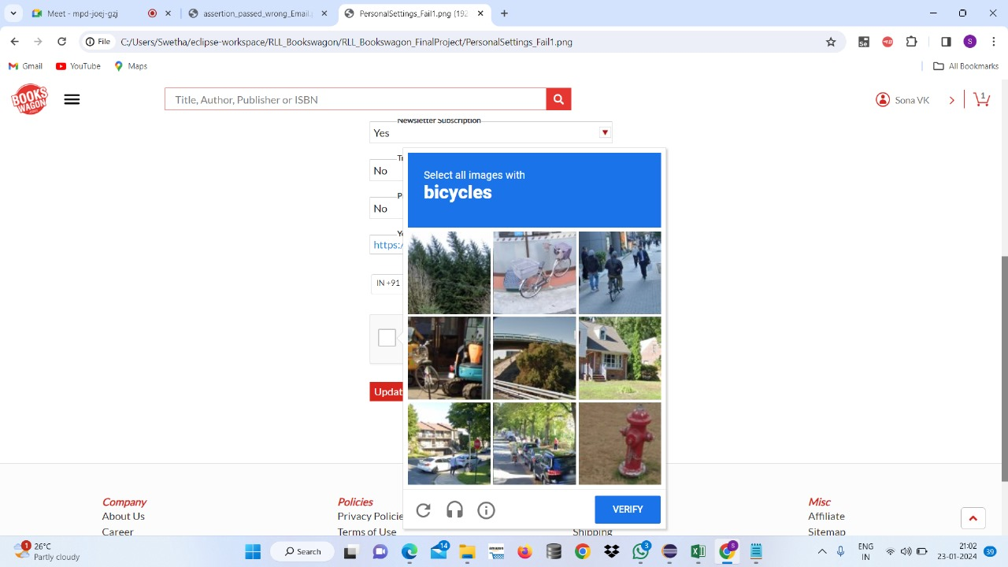
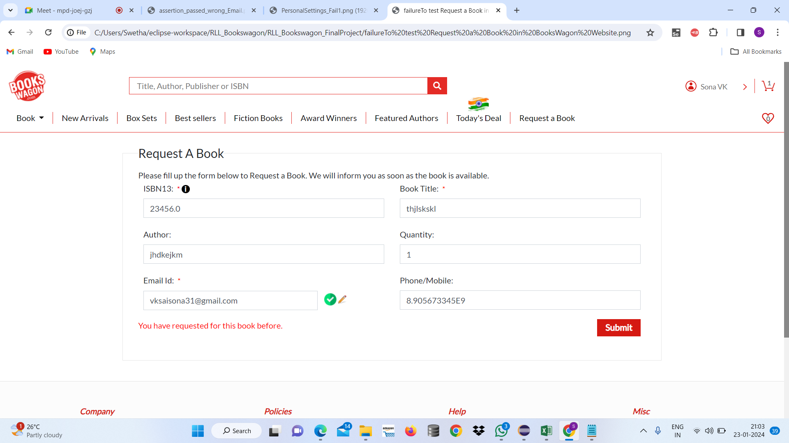
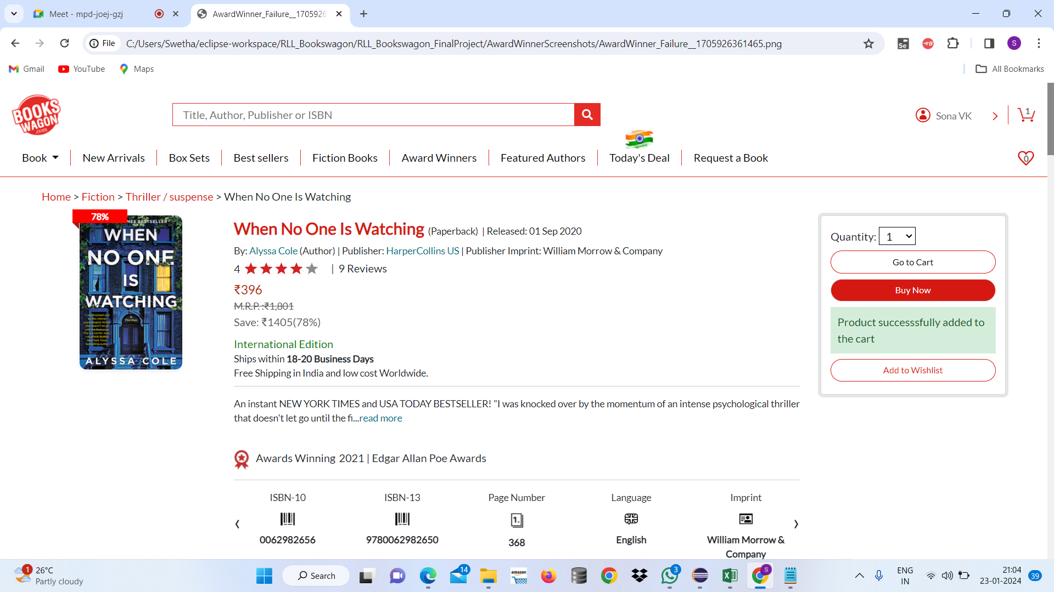
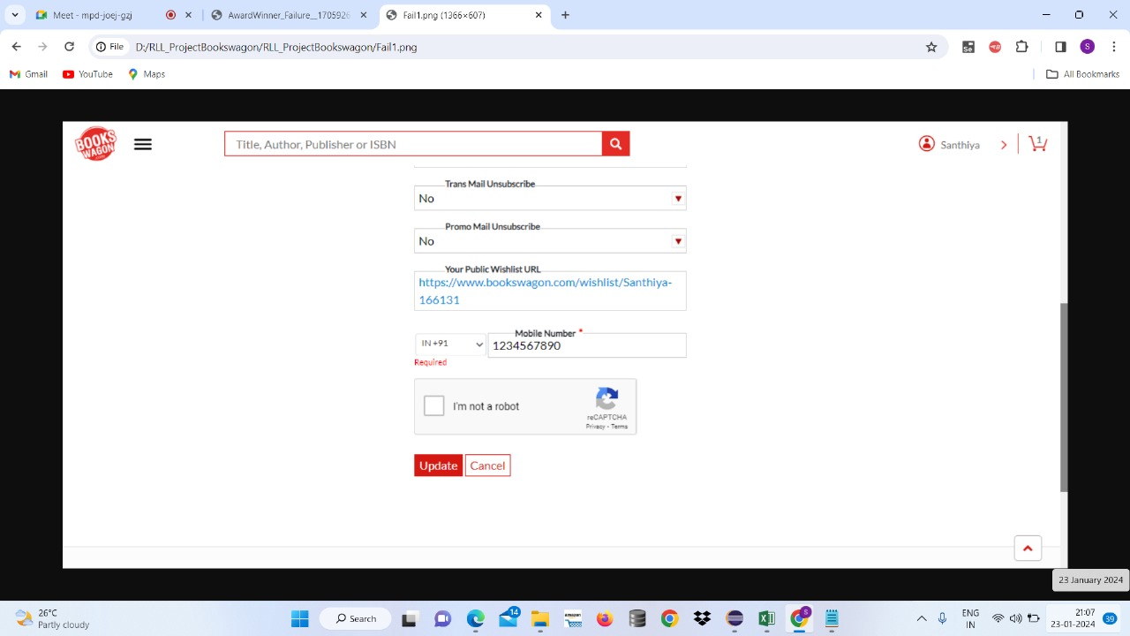
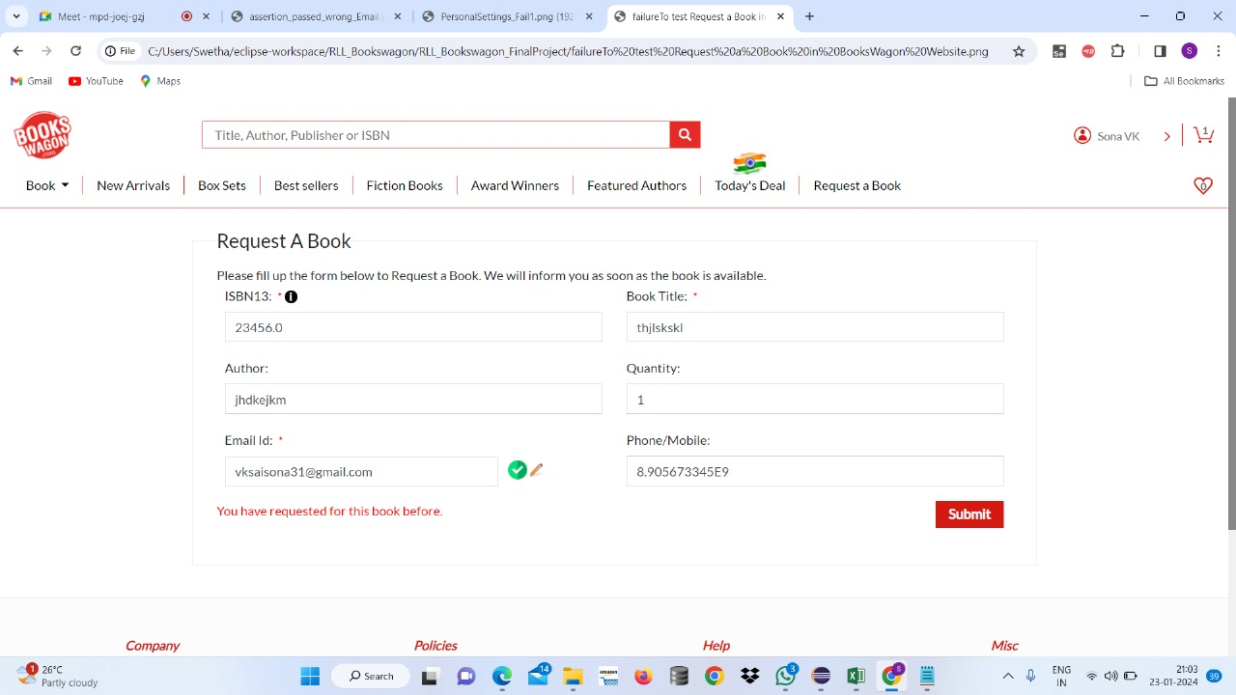

Slide 30
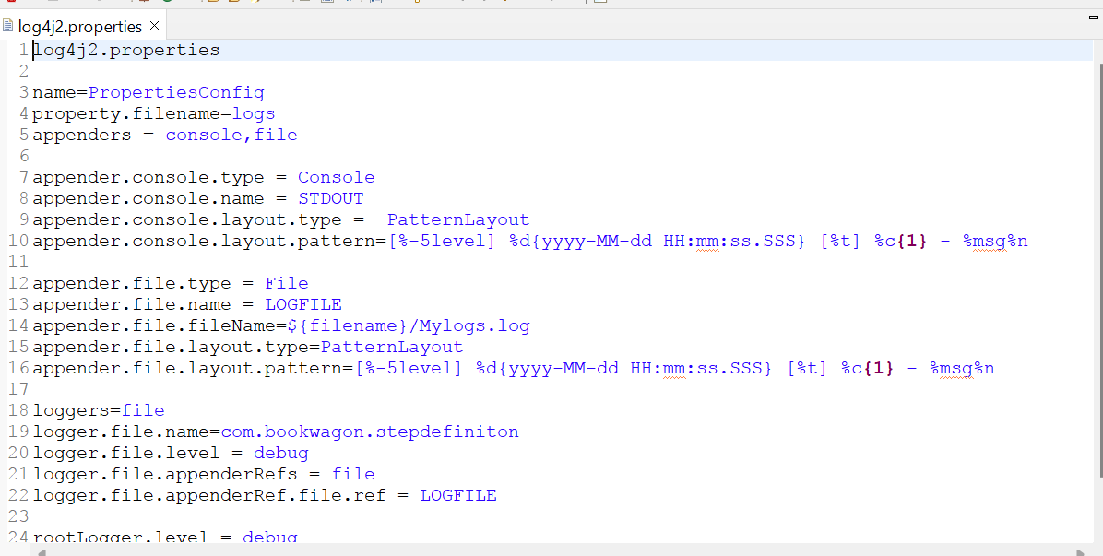
LOGS
Log4j2 is a logging library for Java applications used to log event errors and other information.
Log4j2 properties file is a configuration file used to specify the settings for Log4j2 such as log levels and out destinations.

Slide 31
ADVANTAGES OF EXTENT REPORTS
1
HTML Reports
2
Real-Time Reporting
It provides real time updates during test execution as tests are running the reports are updated dynamically allowing testers to monitor progress and identify issues as they occur.
HTML reports provides a detailed view of test execution and makes easy to understand test results.
3
Screenshots and log
Information
4
Supports for Multiple platforms
Allows testers to attach screenshots or log messages to each step of the test its makes better understandable the flow of test execution.
It supports multiple testing frameworks and platforms including TestNG , Junit and others it also makes suitable for automation projects.

Slide 32

DATA DRIVEN TESTING
Data-driven testing: a software testing technique that stores test input and expected results in a table or spreadsheet, so that a single control script can execute all of the tests in the table.
In the simplest form the tester supplies the inputs from a row in the table and expects the outputs which occur in the same row. The table typically contains values which correspond to boundary or partition input spaces.

Slide 33
TOOLS FOR DATA-DRIVEN TESTING
Selenium WebDriver: A popular automation tool for web application testing, which supports data-driven testing using various programming languages such as Java, Python, and C#.
Apache JMeter: An open-source performance testing tool that allows data-driven testing for web applications, APIs, and databases.
TestNG: A testing framework for java that supports data-driven testing through
Parameterization of test methods.
Robot Framework: An open-source test automation framework that provides built-in support for data-driven testing using tabular test data syntax.

Slide 34
IMPLEMENTING DATA-DRIVEN TESTING
Identify Test Scenarios: Determine the functionalities of the
application that require data-driven testing.
Create Test Data: Prepare a set of input data covering different
Scenarios, including valid and invalid inputs, edge cases, and
boundary conditions.
Develop Test Scripts: Write test scripts that incorporate the test data and automate the testing process.
Execute Tests: Run the test scripts with different data sets to validate the application’s behavior.
Analyze Results: Evaluate the test Results to identify any deviations from expected outcome and investigation failures.

Slide 35
ADVANTAGES
Reusability: Test scripts can be reused with different data sets, promoting a modular testing approach.
Maintainability: Test scripts and data are kept separate, simplifying updates and reducing the risk of errors during maintenance.
Scalability: Adding new test cases is easy by providing additional sets of test data, enabling efficient scaling of testing efforts.
Coverage: Data-driven testing facilitates comprehensive test coverage by evaluating the same functionality with different data sets.
Efficiency: Automated execution of data-driven tests increases testing efficiency, allowing rapid execution of a large number of test cases.
Versatility: Data-driven testing is adaptable to various testing needs, including functional, regression, and performance testing.

Slide 36
DISADVANTAGES
Complex Setup: Setting up a data-driven testing framework can be complex initially.
Initial Time Investment: There's an initial time investment required for framework setup.
Dependency on Data Quality: Test effectiveness depends on the quality of test data.
Maintenance Challenges: Managing numerous test data sets and scripts can pose maintenance challenges.
Increased Initial Effort: Creating parameterized test scripts may require more effort initially.
Data Security Concerns: Use of sensitive information in test data may raise data security concerns.

Slide 37

JIRA
Jira is a widely used project management and issue tracking tool developed by Atlassian.
It helps teams plan, track, and manage their work through customizable workflows, collaboration features, and detailed reporting.
Whether you call them bugs, tasks, improvements or work requests, JIRA provides an efficient way to track and manage your work - which can have a big impact on productivity and results.

Slide 38
JIRA FEATURES
Secure - JIRA provides fine-grained enterprise level security.
Usable - Intuitive interface designed with both business and technical users in mind.
Track - Keep track of all activities, changes and work logged against issues.
Administration - A low maintenance system with straightforward administration capability.
Extensible - With over 100 plugins contributed by the community.
Open - An open API, full source code access allow for further integration and customization of JIRA functionality.
Roadmaps - Plan and visualize long-term project goals and timelines.

Slide 39
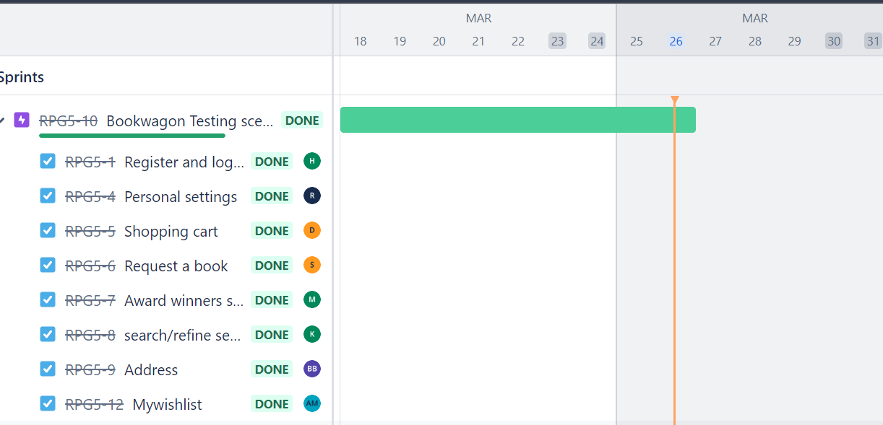
SV

Slide 40
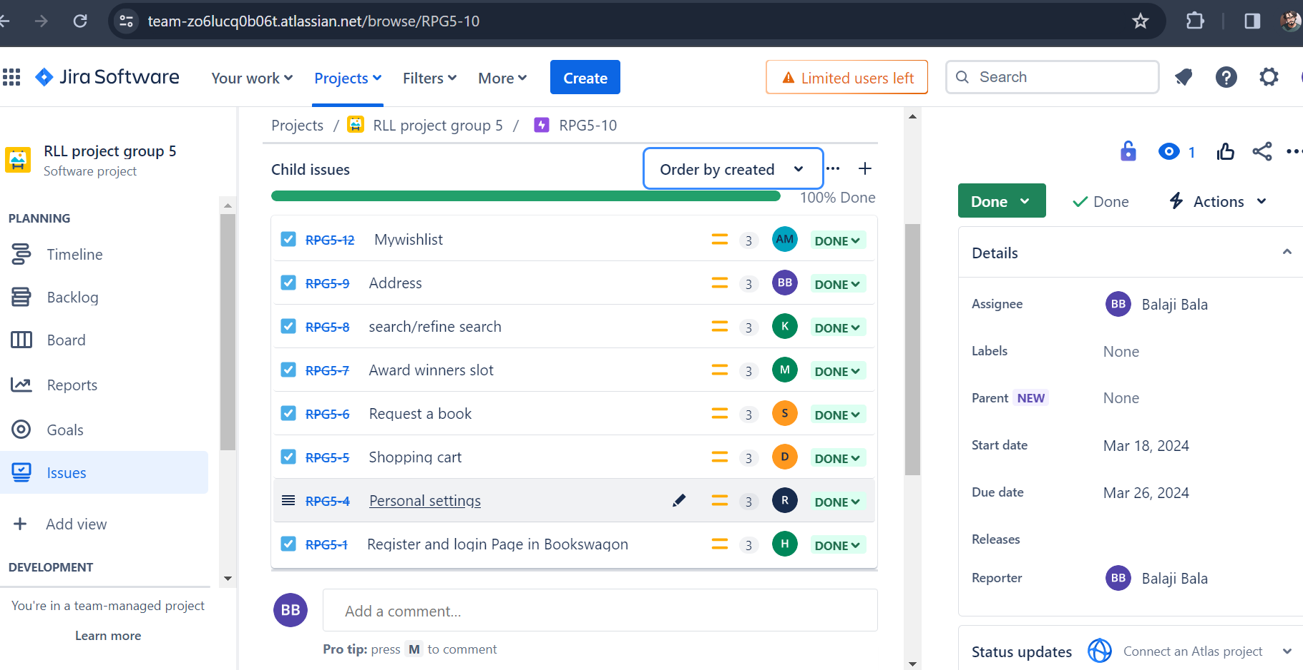
SV

Slide 41
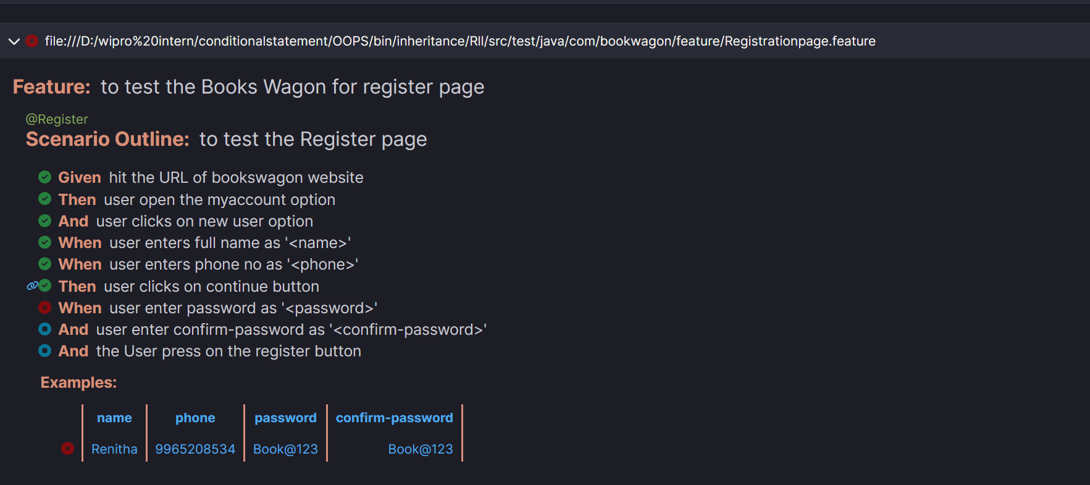
Outputs
SV

Slide 42
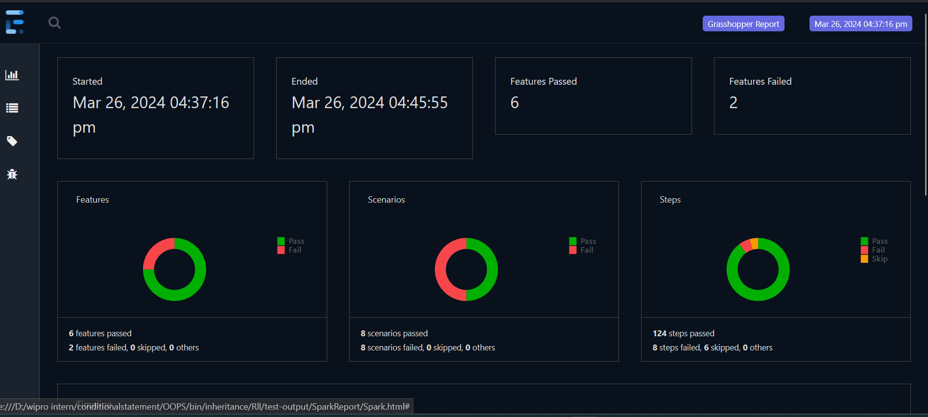
SV

Slide 43
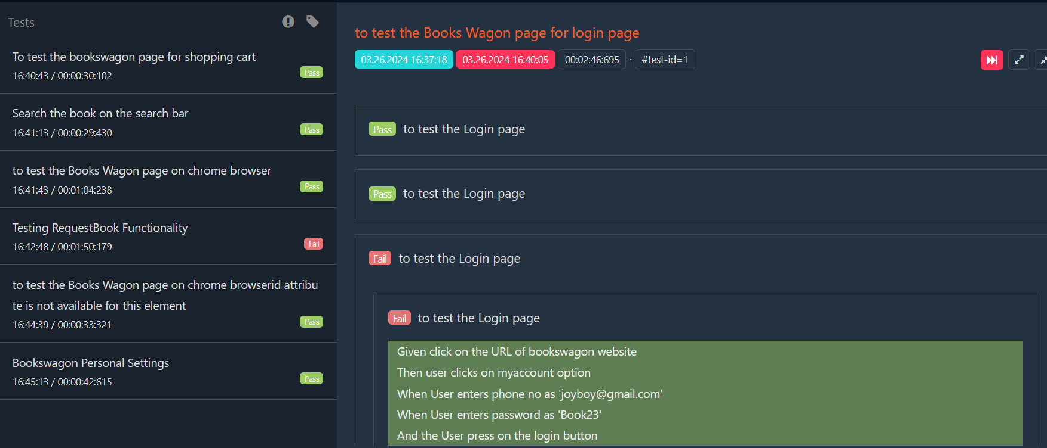
SV

Slide 44
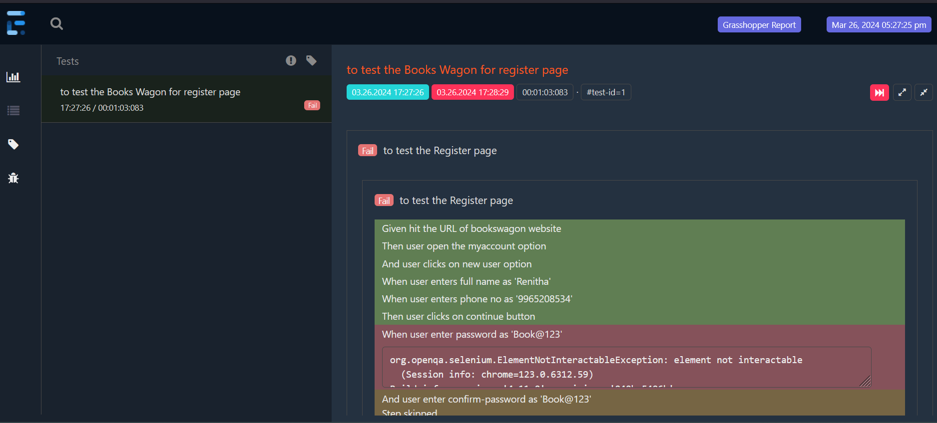
SV

Slide 45
THANK YOU

